Slide 1





IGP Team 3 · Instructor: Hisham Ihshaish
Robo Chat Advisor
Portfolio Advisor
Project Framework
Team Members:
Gordon Gulliford
James Gooch
Kay Roscoe
Sumudu Lakmal Jayawardhana (Lucky)
Thomas Oxley
Covering: Objectives · Research · Methods · Findings · Project Management

Slide 2
AGENDA
Today's Presentation
01
02
03
04
05
Project Topic
& Objectives
Relevant
Research
Methods
Used
Project
Management
Major
Findings
🚀 LIVE DEMO· Happy to demonstrate working tool after presentation. http://5.135.103.183:5173/
Notes:
Our presentation today will address the key elements surrounding our project and its development.
the presentation has been broken down into the following sub-catagories that will feature throughout.

Slide 3
01 · TOPIC & OBJECTIVES
The Problem We Set Out to Solve
THE BARRIERS
60%
1
Financial advice is expensive
Professional advisors charge 1–3% AUM, putting them out of reach of beginners
Alternatively, ”Robo-advisors” are becoming more popular but many still feel uneasy towards their usage, and some can become uneconomical due to trading fee’s.
2
Investment platforms feel intimidating
of UK adults
Without diversification frameworks, retail investors load on familiar names, exposing themselves to additional risks .
Illiterate investors can often misjudge markets and assets, with mismatching portfolio arrangements to suit their goals.
hold no investments outside cash savings
3
DIY investors over-concentrate
Investment Platforms do not provide the platform to make well considered decision internally, leaving users relying on personal knowledge .
Existing tools miss the middle – either assume prior knowledge of risk, asset classes and portfolio theory, or provide only basic calculation tools for compounding interest.
Source: FCA Financial Lives Survey, 2024
Notes:
1. Financial advice is expensive
Professional advisors charge 1–3% AUM, putting them out of reach of beginners
Alternatively, ”Robo-advisors” are becoming more popular but many still feel uneasy towards their usage, and some can become uneconomical due to trading fee’s.
2. Investemnt platforms can be intimaidating
Illiterate investors can often misjudge markets and assets, with mismatching portfolio arrangements to suit their goals.
3. DIY investors over-concerntrate
Investment Platforms do not provide the platform to make well considered decision internally, leaving users relying on personal knowledge .
Without diversification frameworks, retail investors load on familiar names, exposing themselves to additional risks .
Existing tools are essentially missing the middle – either assume prior knowledge of risk, asset classes and portfolio theory, or provide only basic calculation tools for compounding interest.

Slide 4
01
02
03
04
05
Project Topic
& Objectives
Relevant
Research
Methods
Used
Project
Management
Major
Findings
01 · TOPIC & OBJECTIVES
Our Project Objectives
Accessible
Quantitatively Sound
Personalised
Transparent
Replace financial jargon with a guided chat the user understands.
Use a combination of Financial models to provide suitable and sound analysis
Tailor recommendations based of sectors, Time horizons, amounts, and risk
Analytical breakdown and plain English explanations
Simplifying the Complexities of Investing
Assisting users on building and optimising their investments to suit their needs.
Simplifying the Complexities of Investing
Making investing simpler
Complex made simple
A simple tool assisting in a complex way
Assisting users on building and optimising their investments to suit their needs.
Notes:
Our proposition sets to address the lack of public retail investor tools, targeting new-to-novice investors, our tool will set out to provide an analytical tool for investors to make better choices

Slide 5
03 · Methods Used
Blending Four Return Estimators
Each estimator has different biases. We blend them so no single model can dominate the result.
MPT
1952
CAPM
1964
APT
1976
ML
Modern
Modern Portfolio Theory
Capital Asset Pricing Model
Arbitrage Pricing Theory
Machine Learning
HOW
HOW
HOW
HOW
Historical mean returns, inflation-adjusted
Beta regression vs market benchmark
PCA factor analysis with ridge regression
Ridge regression with TimeSeriesSplit CV
STRENGTH
STRENGTH
STRENGTH
STRENGTH
Simple, transparent, well-understood
Discounts excess return for systematic risk
Captures multiple sources of co-movement
Adapts to short-term patterns
Blend weight: 21.7%
Blend weight: 21.7%
Blend weight: 21.7%
Blend weight: 35.0%
Optimiser: scipy.optimize.minimize (SLSQP) maximises the Sharpe ratio subject to weight constraints (max 20% per asset).
Team 3 — IGP Sept 2025
12 / 18
Notes:
Given the vast array of investment frameworks, providing a system that combines these can allow for maximisation off analytical rigour and optimal portfolio arrangemnets, these are combined with a machine learning model and memory system that, can provide adaptive interprations and assist in return and risk foracsting

Slide 6
02 · Relevant research
Academic Foundations of the Model
OUR MODEL DRAWS ON 70+ YEARS OF PORTFOLIO THEORY
1952
1964
1976
1992
Markowitz
Sharpe
Ross
Fama & French
Modern Portfolio Theory
Linked expected returns to systematic risk via beta. Nobel Prize 1990.
Arbitrage Pricing Theory
Three-Factor Model
Formalised diversification through mean-variance optimisation. Nobel Prize 1990.
CAPM
Generalised CAPM to allow multiple risk factors driving returns.
Empirical evidence that size and value factors explain returns alongside market.
Why this matters: We blend all four estimators rather than relying on any single one — robust to any single model failing.
9 / 18
Notes:
thse Core financial models have been developed since mid 20th century and continue to prove as pillars in investment analysis and why these are the backbone to the programs calculation and data processing powers.

Slide 7
03 · Methods Used
What the Models Tell Us
01
02
03
Diversification works as expected
Risk score meaningfully shifts allocation
Monte Carlo reveals true risk
Portfolios spanning 4+ sectors produce Sharpe ratios 25–40% higher than single-sector portfolios with the same expected return.
A user with risk score 1 receives 70% government bonds, 30% equities. A user with risk score 5 receives 90% equities, 10% bonds. Identical inputs otherwise.
10-year £10k investments show median outcomes of £18-25k, but 10th percentile outcomes can fall below £10k. Single-line projections would hide this risk.
+34%
avg. Sharpe improvement
60%
allocation swing
5–95%
outcome range shown
Notes:
Data testing shows diverificarion is crucial in mitigating investment risks, a fundamentl error mist novice investors make.
Effectivly analysising and encorporating risk into investment rational is pivotal in shaping portfolios and their asset allocations, reflecting on the investors appetite for risk
Suplimenting results with regreesion and ramdon seed testing such Monte carlo simulations allows for an extended bredth to return forecasting and risk appraisals, cultivating a large set of random scenarios alongside a Machine larning engine, captures an intense amount of possible outcomes and simplifies this that we can use to better understand the portfolios future

Slide 8
03 · Methods Used
Validation: Model vs Excel Reference
We cross-checked every output against an independently built Excel reference model.
<0.5%
100%
2
✓
Maximum deviation
Test coverage
Validation stages
Sign-off
between our model and the Excel reference across all tested portfolios
all 9 sectors and 30+ tickers tested across multiple risk profiles
small subset test, then full asset universe with realistic inputs
model approved for production deployment after validation report
EXAMPLE: MODERATE RISK PORTFOLIO (£10,000 · 60 months · All sectors)
Metric | Model | Excel | Deviation
Expected Return | 8.7% | 8.7% | 0.0%
Volatility | 14.2% | 14.3% | 0.07%
Sharpe Ratio | 0.92% | 0.91% | 0.01%
Sortino Ratio | 1.34% | 1.32% | 0.02%
Notes:
Running tradditinal excel models of these frameworks allowed us test the various cababilites and processes of the programe to ensure validity amongst the results, these were tested on individual asset technical analysis, and sub-sets of controlled historic stock price data captured through the Bloomberg terminal to test portfolio construction capabilities.

Slide 9

02 · Relevant research
Market Research: Adoption
Growing Interest
66% of US users would consider robo-advisers
UK: 3% use trading apps, 50% aged 18–34
53% unlikely to trust AI-driven financial advice
Only 19% trust robo-advisers with investment decisions
Demand exists, but trust remains the main adoption barrier
Notes:
We researched who, type of people who would most likely use a robo-advisor
This is documented in our portfolio

Slide 10
02 · Relevant research
Market Research: Opportunity
UK Market Growth
Investment platform use: 8.4% → 15%
Non-advised investing: 5.9% → 11%
Only 8.6% receive financial advice
Strengths and Limitations of Robo-advisors
low cost and accessible
yet lack personalisation.
Notes:
We researched who, type of people who would most likely use a robo-advisor
This is documented in our portfolio

Slide 11
02 · Relevant research
Market Research: Robo-Advisor Landscape
HOW WE COMPARE
$2.3T
Provider | Min. Investment | Annual Fee | Custom Sectors
Nutmeg | £500 | 0.45% | Limited
Walthify | £1 | 0.60% | No
MoneyFarm | £500 | 0.75% | Limited
Our Total | £1 | Free | Yes
global AUM
managed by robo-advisors in 2025
Projected to reach $5.9T by 2030
Insight Existing platforms target users who can already commit £500+. We saw a gap at the entry level — an educational-first tool with no minimum.
(Statista, 2025)
9 / 18

Slide 12
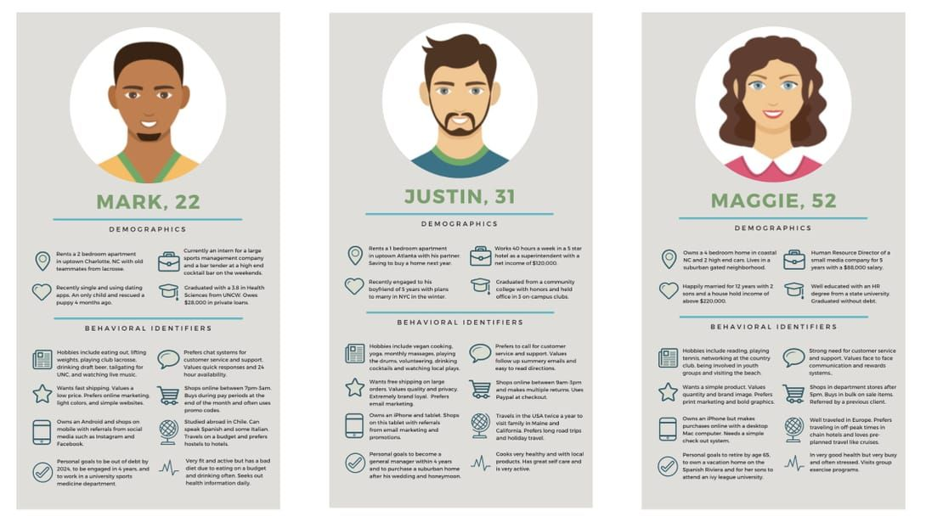
I tried to help by adding some visual and formatting to the page, I didn’t change anything you had wrote or did.
🎓
Age 22-30
The Curious Beginner
Recent graduate, first salary, hears about investing from friends but has never bought a share.
02 · Relevant research
Market Research: User Persona’s
PRIMARY GOAL
Learn safely with small amounts
To help understand exactly who the end user we were designing for is, we incorporated the creation of personas in the research stage so we could simulate their journey through the app and ascertain what the unique needs for different people were.
💼
Age 30-45
🎓
Age 22-30
💼
🏡
The Saving Professional
Age 30-45
Age 45-60
Mid-career, has cash savings sitting in low-interest accounts, knows they should be investing.
The Curious Beginner
The Saving Professional
The Future Planner
Recent graduate, first salary, hears about investing from friends but has never bought a share.
Mid-career, has cash savings sitting in low-interest accounts, knows they should be investing.
Established career, pension in place, looking to supplement retirement with extra investments.
PRIMARY GOAL
Move savings into a balanced portfolio
🏡
Age 45-60
PRIMARY GOAL
Age 22-30
PRIMARY GOAL
PRIMARY GOAL
Learn safely with small amounts
Move savings into a balanced portfolio
Optimise risk-adjusted returns over 10–20 years
The Future Planner
Established career, pension in place, looking to supplement retirement with extra investments.
PRIMARY GOAL
Optimise risk-adjusted returns over 10–20 years
Notes:
We researched who, type of people who would most likely use a robo-advisor
This is documented in our portfolio

Slide 13
Same here
02 · Relevant research
Front End Design
Core Principles – centred around:
Accessibility
Trust
Feed into each other – together will make an inexperienced user feel comfortable
Considers User. Research informed.
Wireframes
Made in Canva.
Directs web dev.
Avoids wasting time.
User Journey
1. Chat Assessment – conversational risk profiling. Research has shown that social cues and dialogue builds trust in users.
2. Input Screen -
Adjust Input. Allows control of process. Convenience. Trust centric.
3. Suggested Portfolio -
Suggested investments. Projected returns. Export button OR return to input. Sorted into tabs to avoid overload

Slide 14
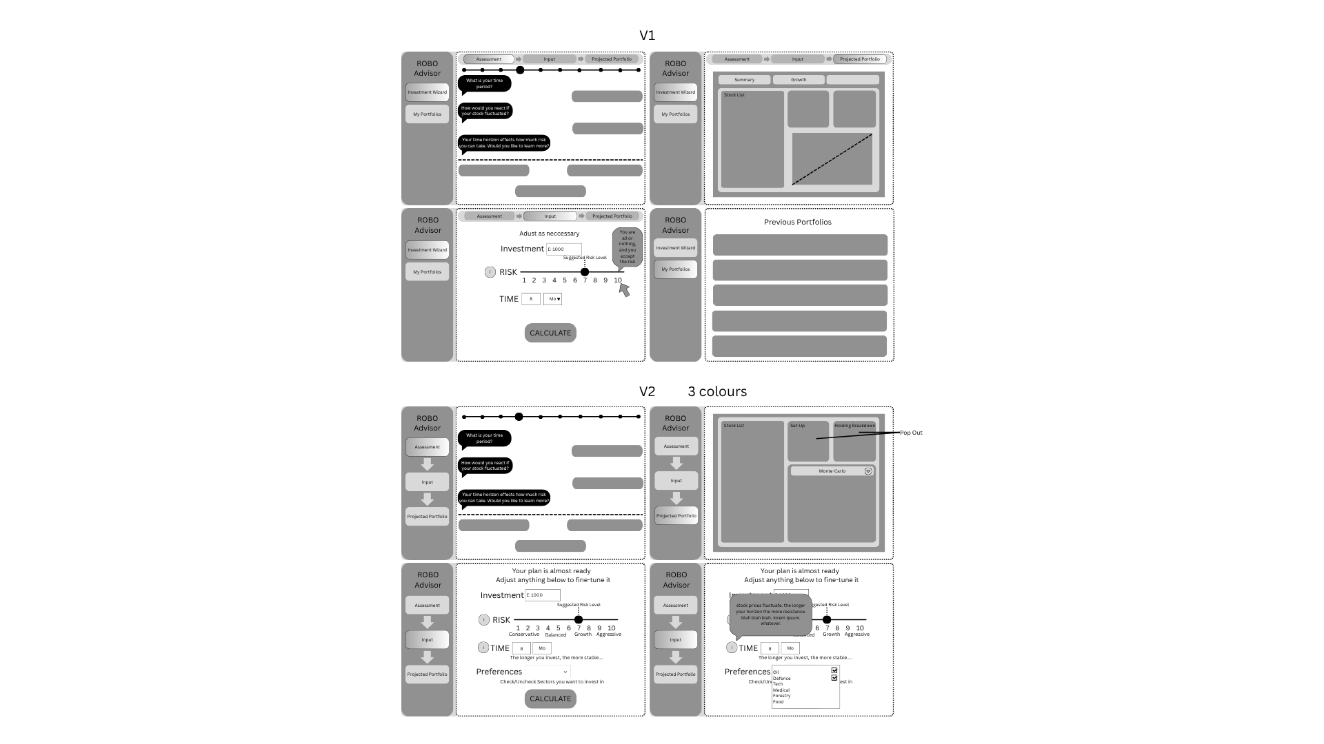
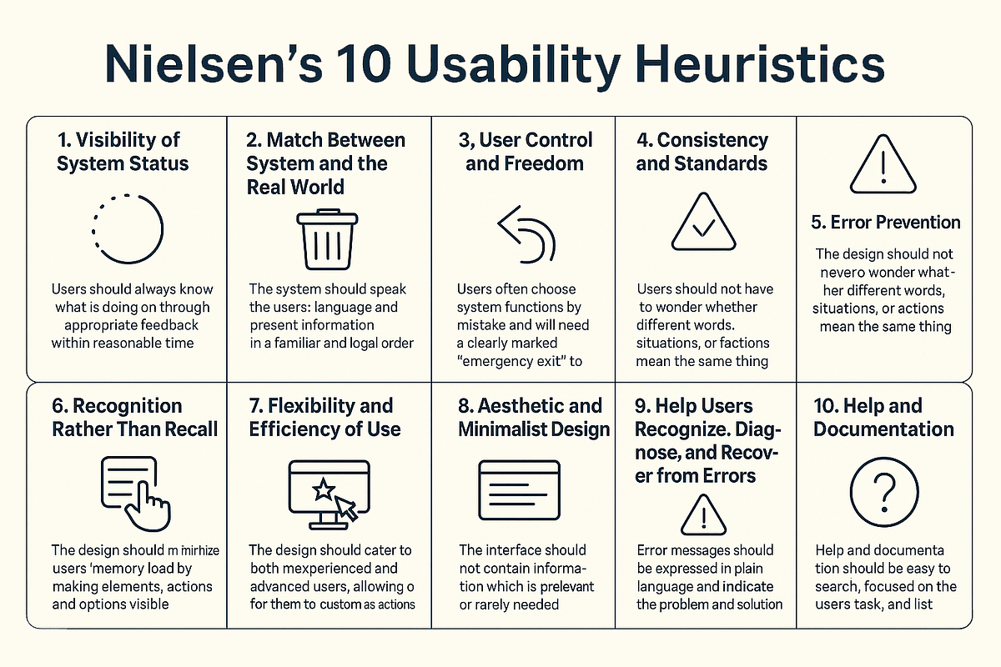
A liitle here but not much,
02 · Relevant research
UI Design Fundamentals
Nielsen’s Usability Heuristics
Intuitive and low friction
Clear where in the process the user is and ability to go back – progress tracker
Hierarchy of elements
Minimalist design
Colour limited, professional and meaningful
Accessibility Considerations – contrast, size, colour

Slide 15
Iteration
Communication with front-end development
Adjustments in response to feedback
Scope creep kept in check.
Wireframe let us simulate the user experience for testing without building it.
Limitations
No live preview

Slide 16




Alternative backend development
Technology Stack
At a glance
Python / Flask – run from Git Bash
Adapted Tom’s calculations for backend use
Server-side routing and form handling – app.py
Four coding files: app.py, calculate.py, mapping.py & plots.py
+ index.html (in templates folder)
HTML/CSS – (includes tooltips)
Style sheet for the UI – index.html
Flask POSTs → calculate.py runs optimisation
Plotly
I5 graphs – plots.py
Runs on local host: http://127.0.0.1:5000/
calculate.py
All optimisation & simulation logic (unchanged from original model)
Results page: weights, Sharpe Ratio, Expected return, MC growth chart, Correlation Heatmap
Notes:
CSS (Cascading Style Sheets) is a stylesheet language used to control the presentation of HTML or XML documents. It defines how elements should be displayed on screen, paper, or other media, enabling developers to separate content (HTML) from design. This separation improves maintainability, reusability, and consistency across web pages.
CSS works by applying rules to HTML elements. Each rule consists of a selector (which targets elements) and a set of declarations (property-value pairs) that define the style.
Plotly is an interactive, open-source plotting library for Python that supports over 40 unique chart types, covering a wide range of statistical, financial, geographic, scientific, and 3-dimensional use-cases. Built on top of the Plotly JavaScript library (plotly.js), Plotly enables Python users to create beautiful interactive web-based visualizations that can be displayed in Jupyter notebooks, saved to standalone HTML files, or served as part of pure Python-built web applications using Dash.

Slide 17
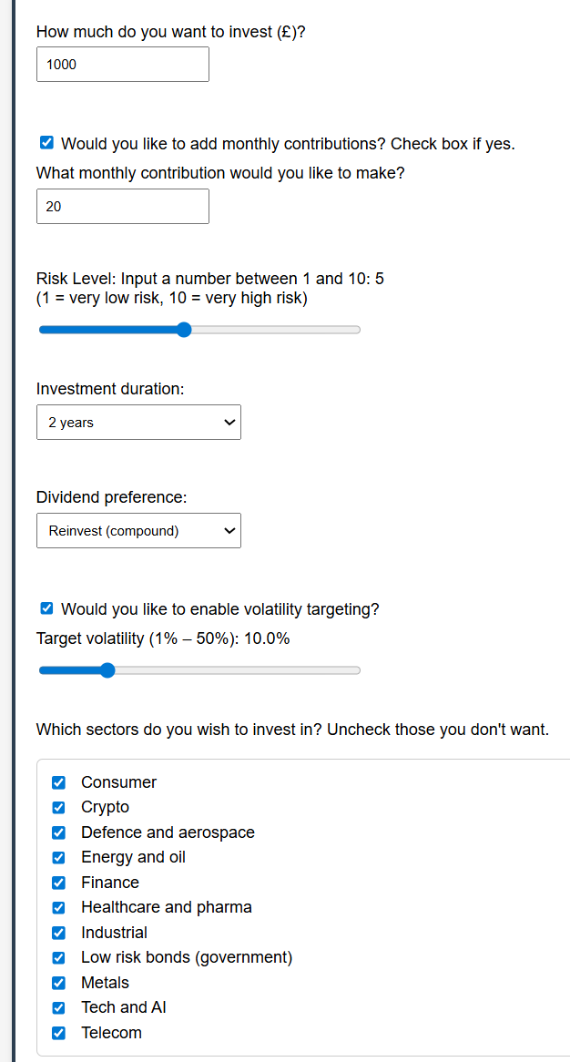
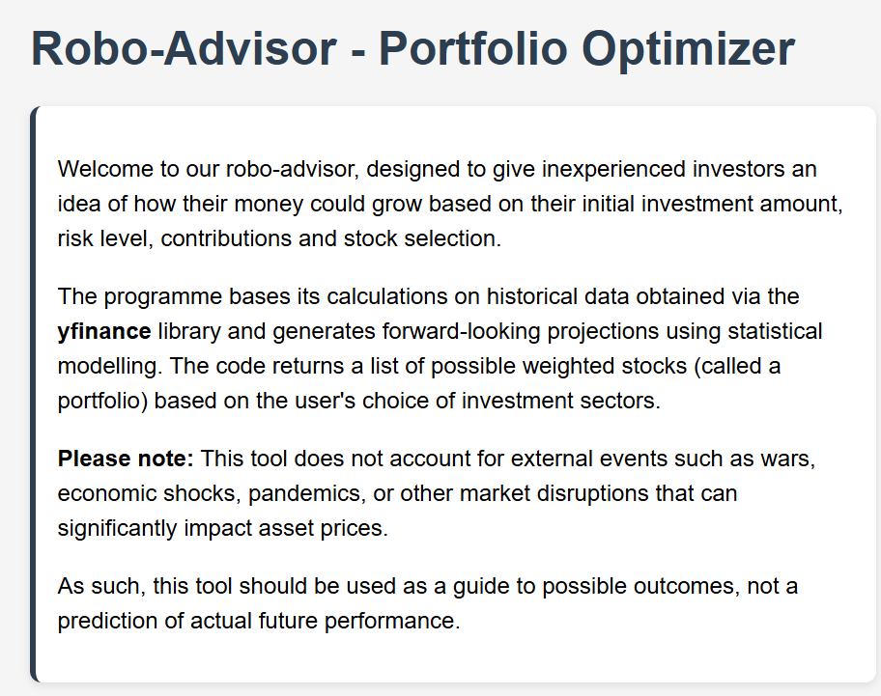
Alternative UI interface
🚀 Runs on port:
http://127.0.0.1:5000/
Please ask if you’d like to see a live demo at the end
Notes:
Tooltips

Slide 18
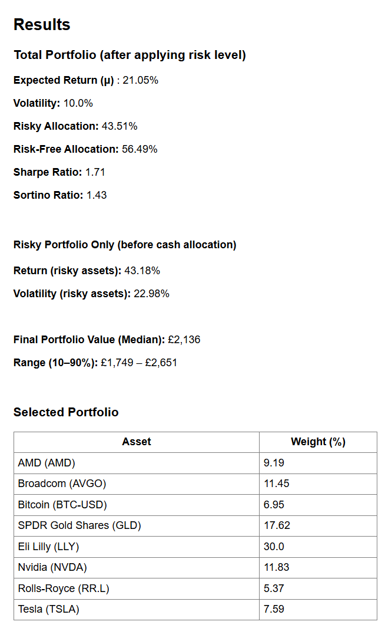
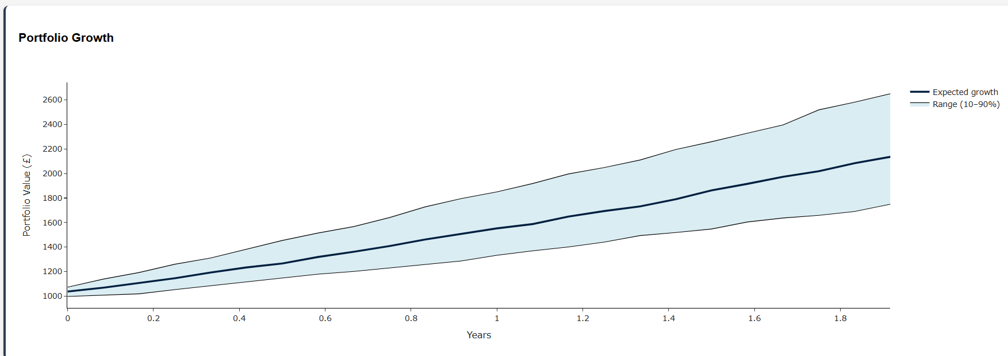
Alternative Portfolio Results
Notes:
On Kay’s version, expected returns are a little high, but reduced when vol targeting added as this reduces risky weighting

Slide 19
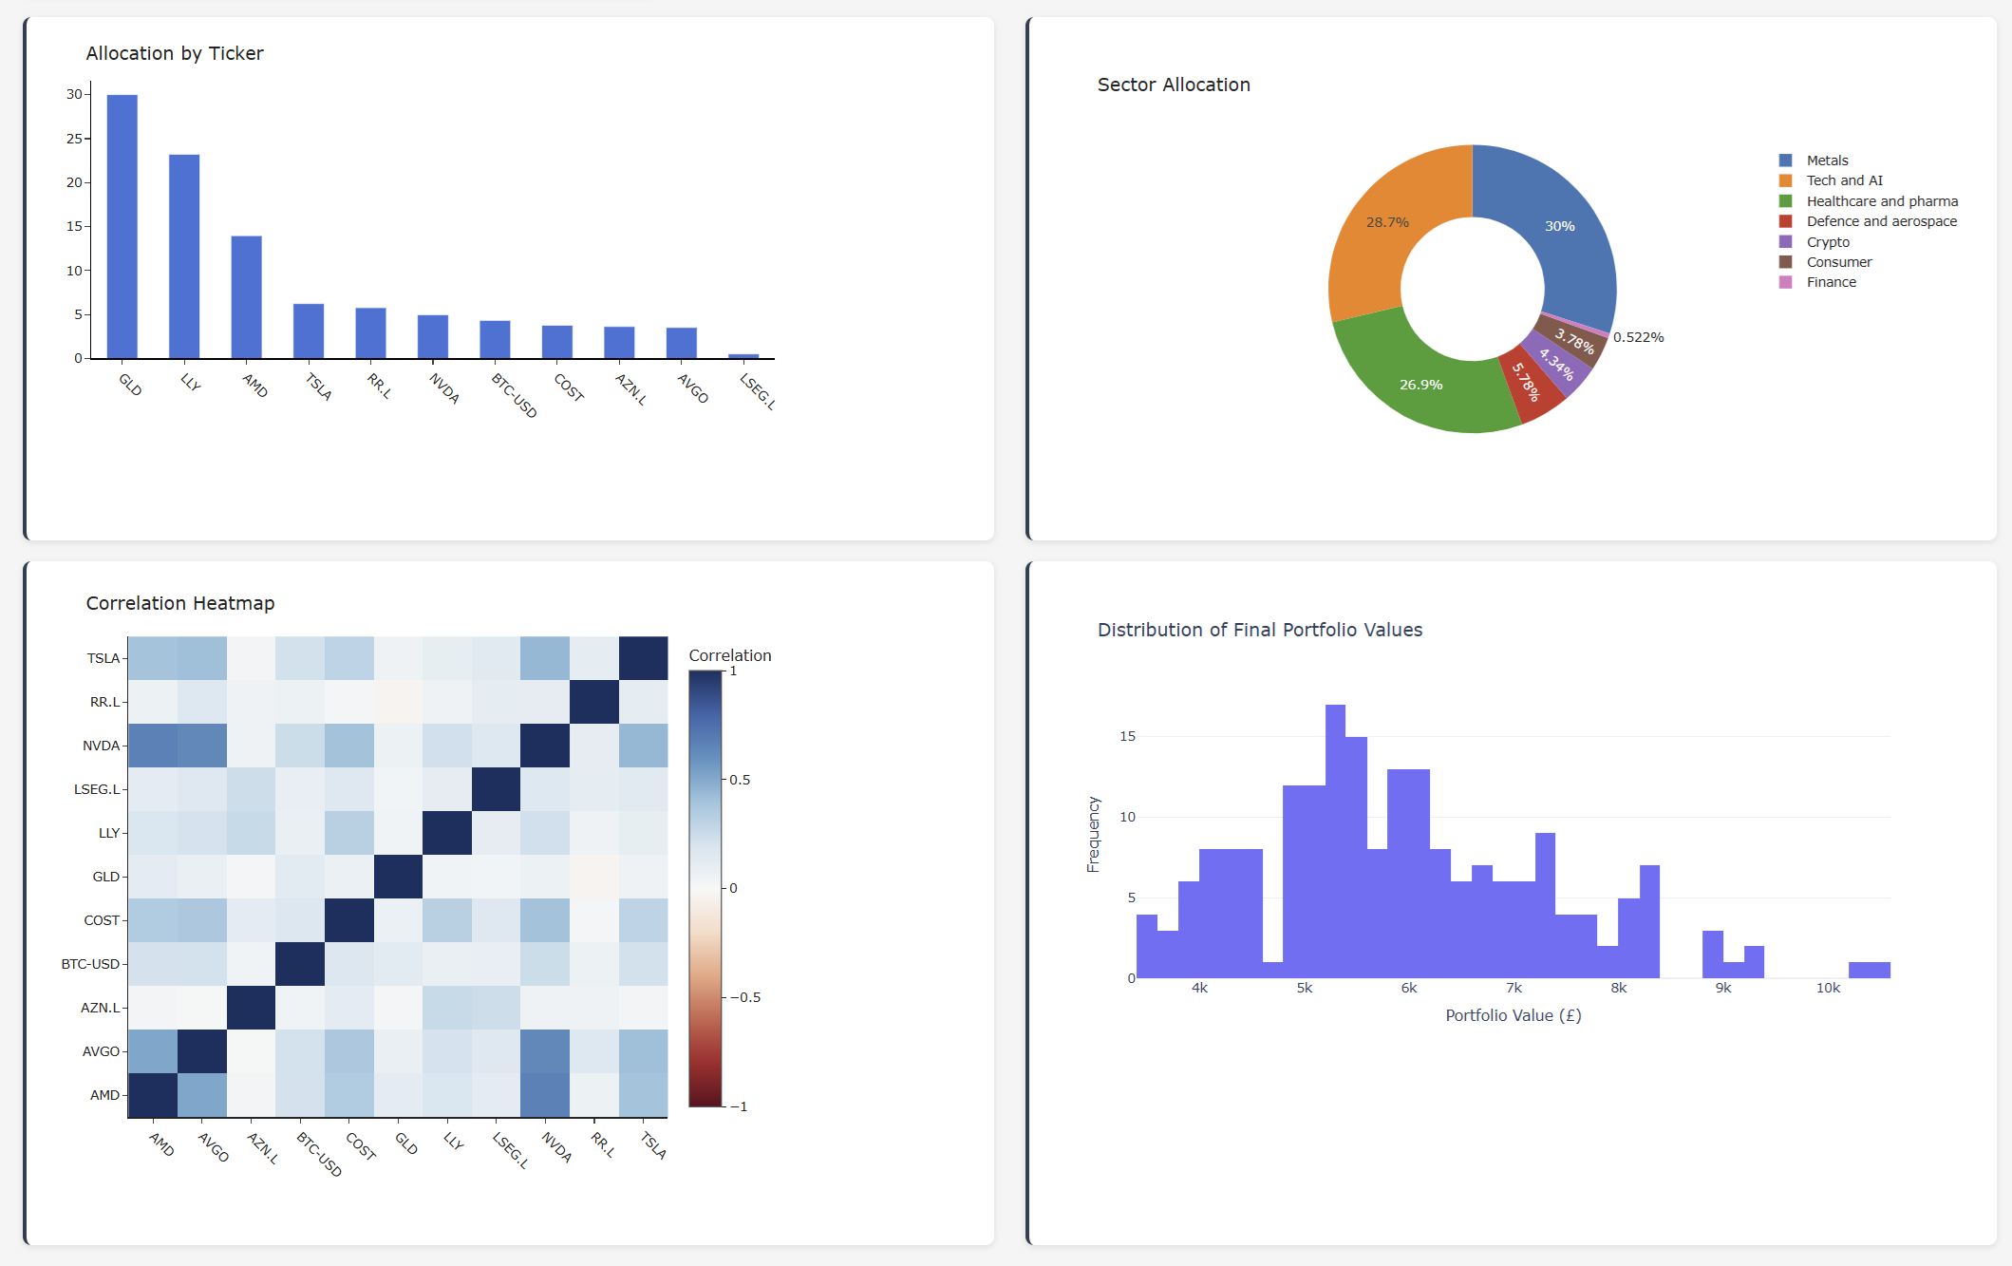
Alternative Portfolio Plots

Slide 20
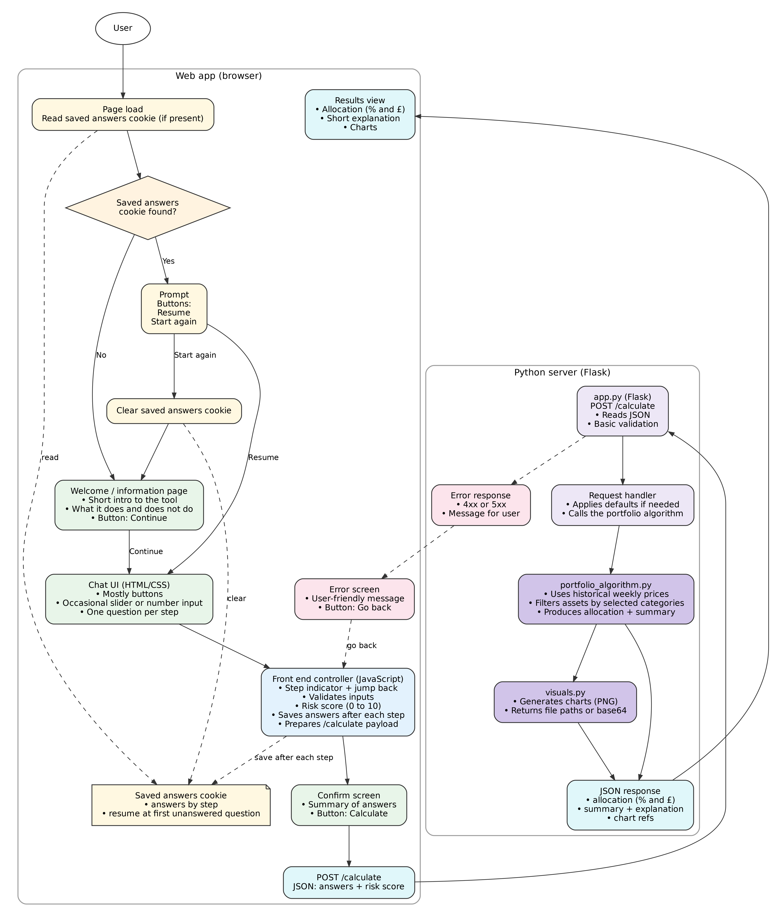
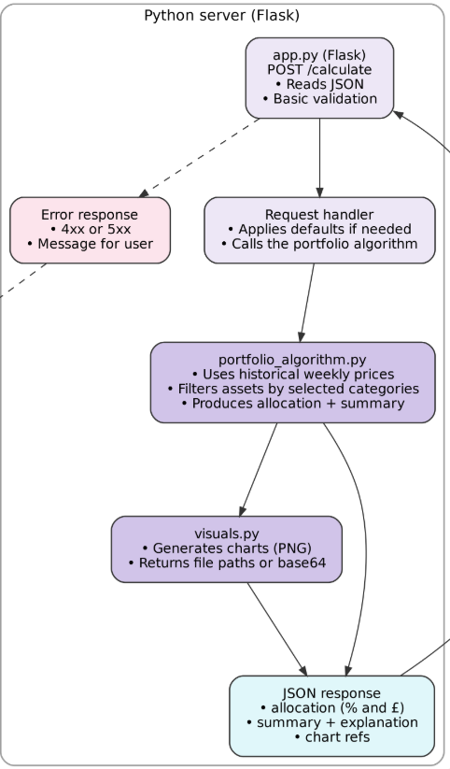
System Architecture Diagram
At the start of March… I finalised this system architecture diagram so we had a shared technical structure to build from.
This is the system architecture diagram!

Slide 21
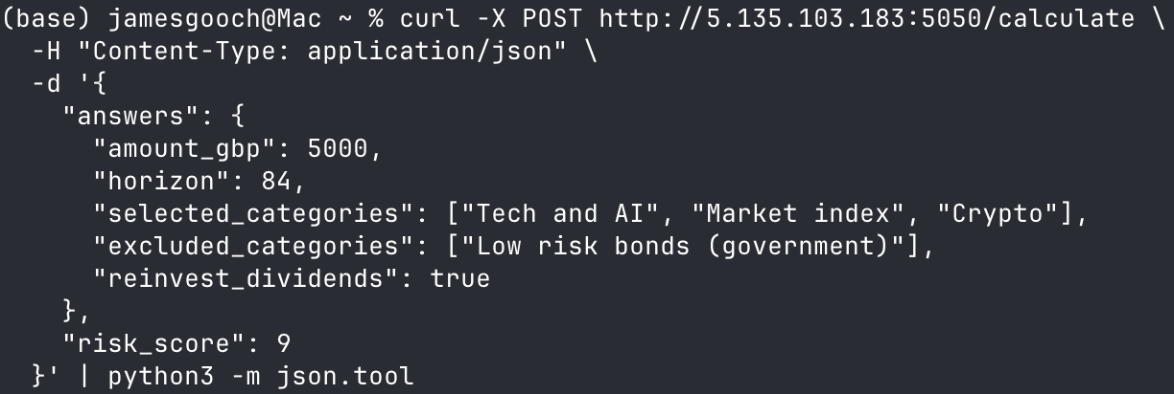
Backend API Contract
The frontend sends one JSON request to /calculate after the questionnaire is complete.
The request contains the user’s investment amount, horizon in months, risk score, category choices and dividend reinvestment choice.
This fixed request shape meant the frontend and backend could be built separately but still connect reliably.

Slide 22
Request Validation
Before the model runs, the backend checks that the frontend request is usable.
Validation checks:
• amount is present and positive
• horizon is a valid month count
• risk score is within the 0-10 range
• selected and excluded categories use allowed names
• the same category cannot be both selected and excluded
Valid requests are normalised before being passed into the model.
Raw JSON
Validation
Cleaned request
Model input

Slide 23
Model Integration
Cleaned request
Tom’s model logic
Optimised allocation
Monte carlo projection
Tom’s notebook contained the core portfolio model.
My backend work was to connect that model into the Flask flow so it could be called from the web app.
After validation, the cleaned request is passed into the portfolio algorithm.
The backend then carries through:
• optimised allocation weights
• Monte Carlo projection values
• chart data for the frontend

Slide 24
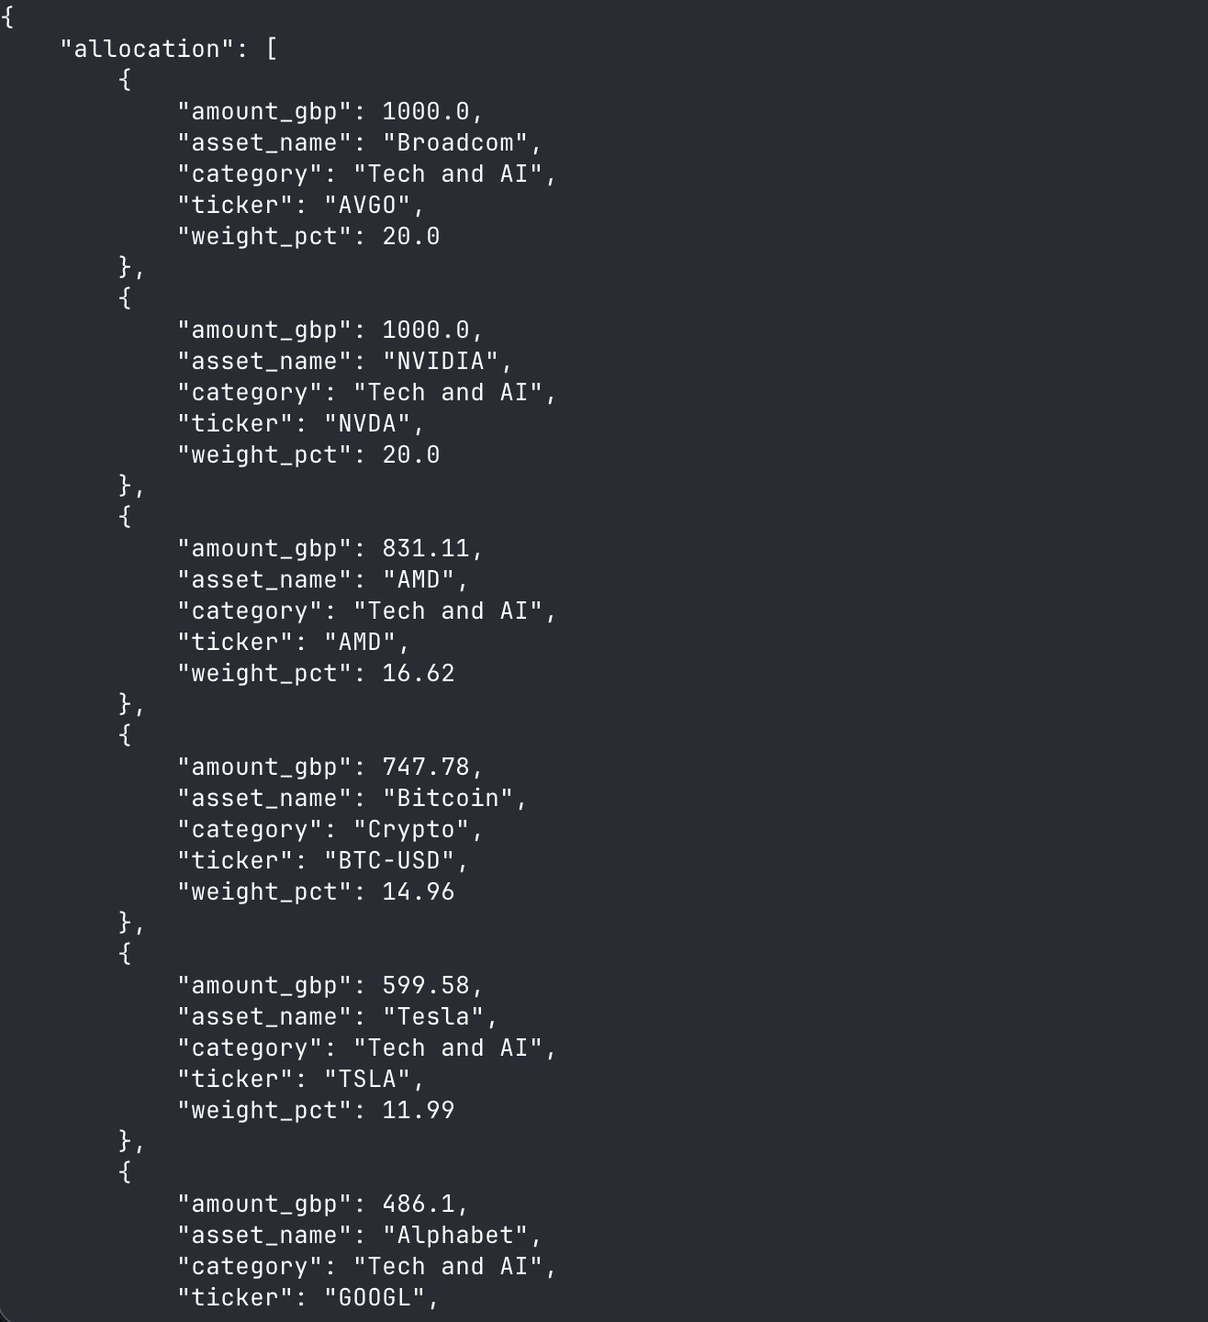
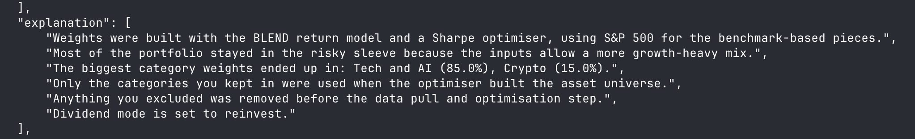
Returning Results to the Frontend
After the model runs, the backend packages the result into one JSON response.
The response includes:
• portfolio allocation rows
• summary metrics and Monte Carlo values
• explanation text
• Plotly chart HTML in chart_refs
This means the frontend can render the results page without running any model logic itself.

Slide 25
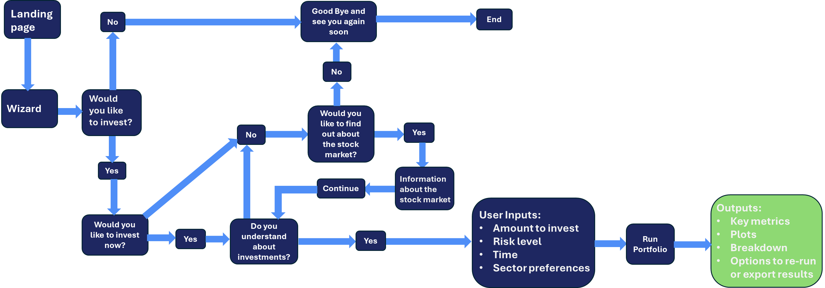
Front end flow diagram – for main version

Slide 26
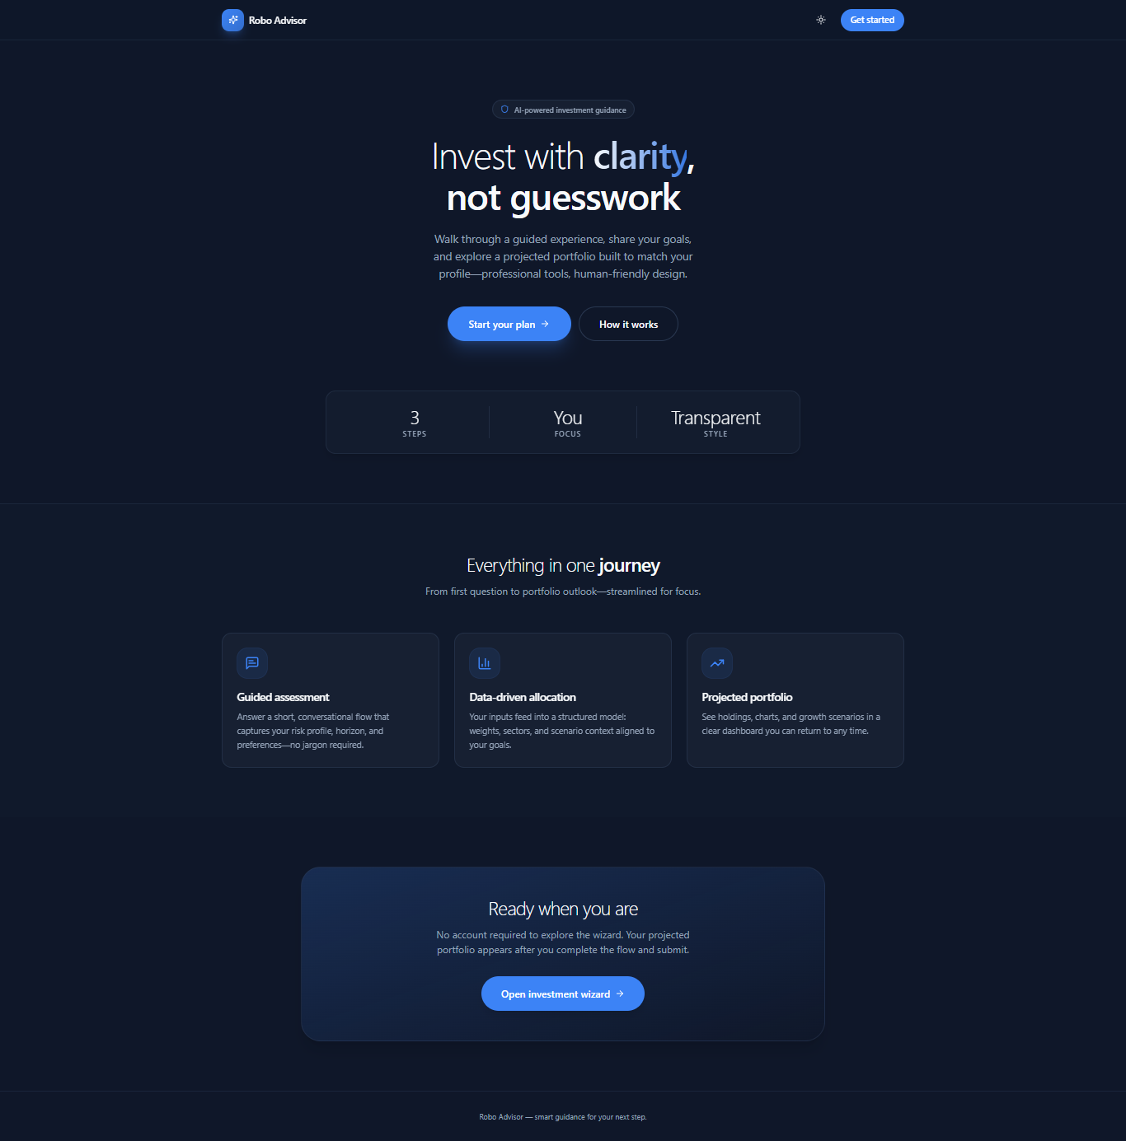
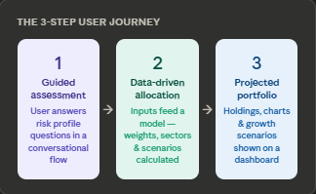
Front end
Key frontend qualities
Focused experience — no account needed, jump straight into the wizard
Transparent style — dark UI with clear data, no hidden steps
Fully responsive — works on mobile, tablet, and desktop
No login barrier — portfolio appears immediately after completing the flow

Slide 27
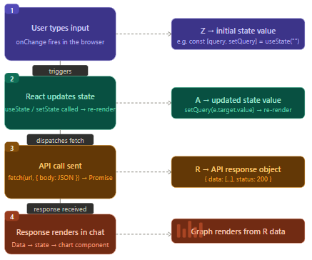



Frontend Technical Stack and Development Workflow
Technology Stack
Task
Built on React 19, Vite 6, and TypeScript for an optimized, type-safe development experience.
Utility-first design using Tailwind CSS, enhanced with Framer Motion for fluid entrance animations.
Frontend is built as a Component-Based Application , where reusable components create a dynamic and seamless user experience
Notes:
CSS (Cascading Style Sheets) is a stylesheet language used to control the presentation of HTML or XML documents. It defines how elements should be displayed on screen, paper, or other media, enabling developers to separate content (HTML) from design. This separation improves maintainability, reusability, and consistency across web pages.
CSS works by applying rules to HTML elements. Each rule consists of a selector (which targets elements) and a set of declarations (property-value pairs) that define the style.
Plotly is an interactive, open-source plotting library for Python that supports over 40 unique chart types, covering a wide range of statistical, financial, geographic, scientific, and 3-dimensional use-cases. Built on top of the Plotly JavaScript library (plotly.js), Plotly enables Python users to create beautiful interactive web-based visualizations that can be displayed in Jupyter notebooks, saved to standalone HTML files, or served as part of pure Python-built web applications using Dash.

Slide 28
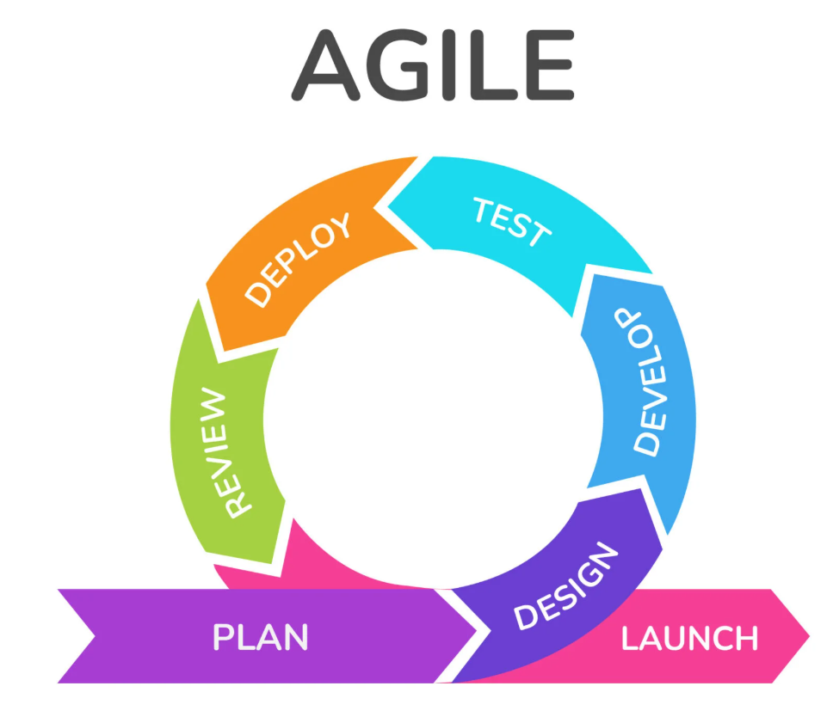
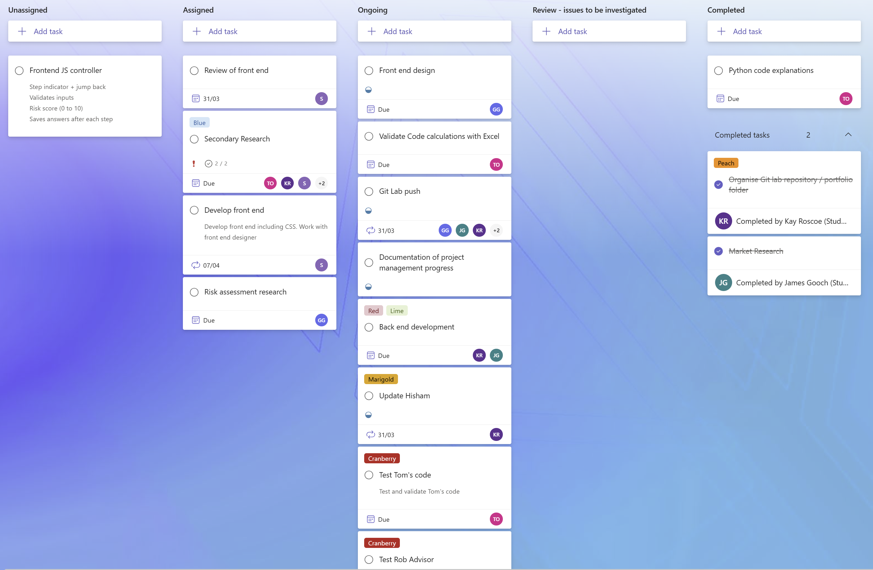
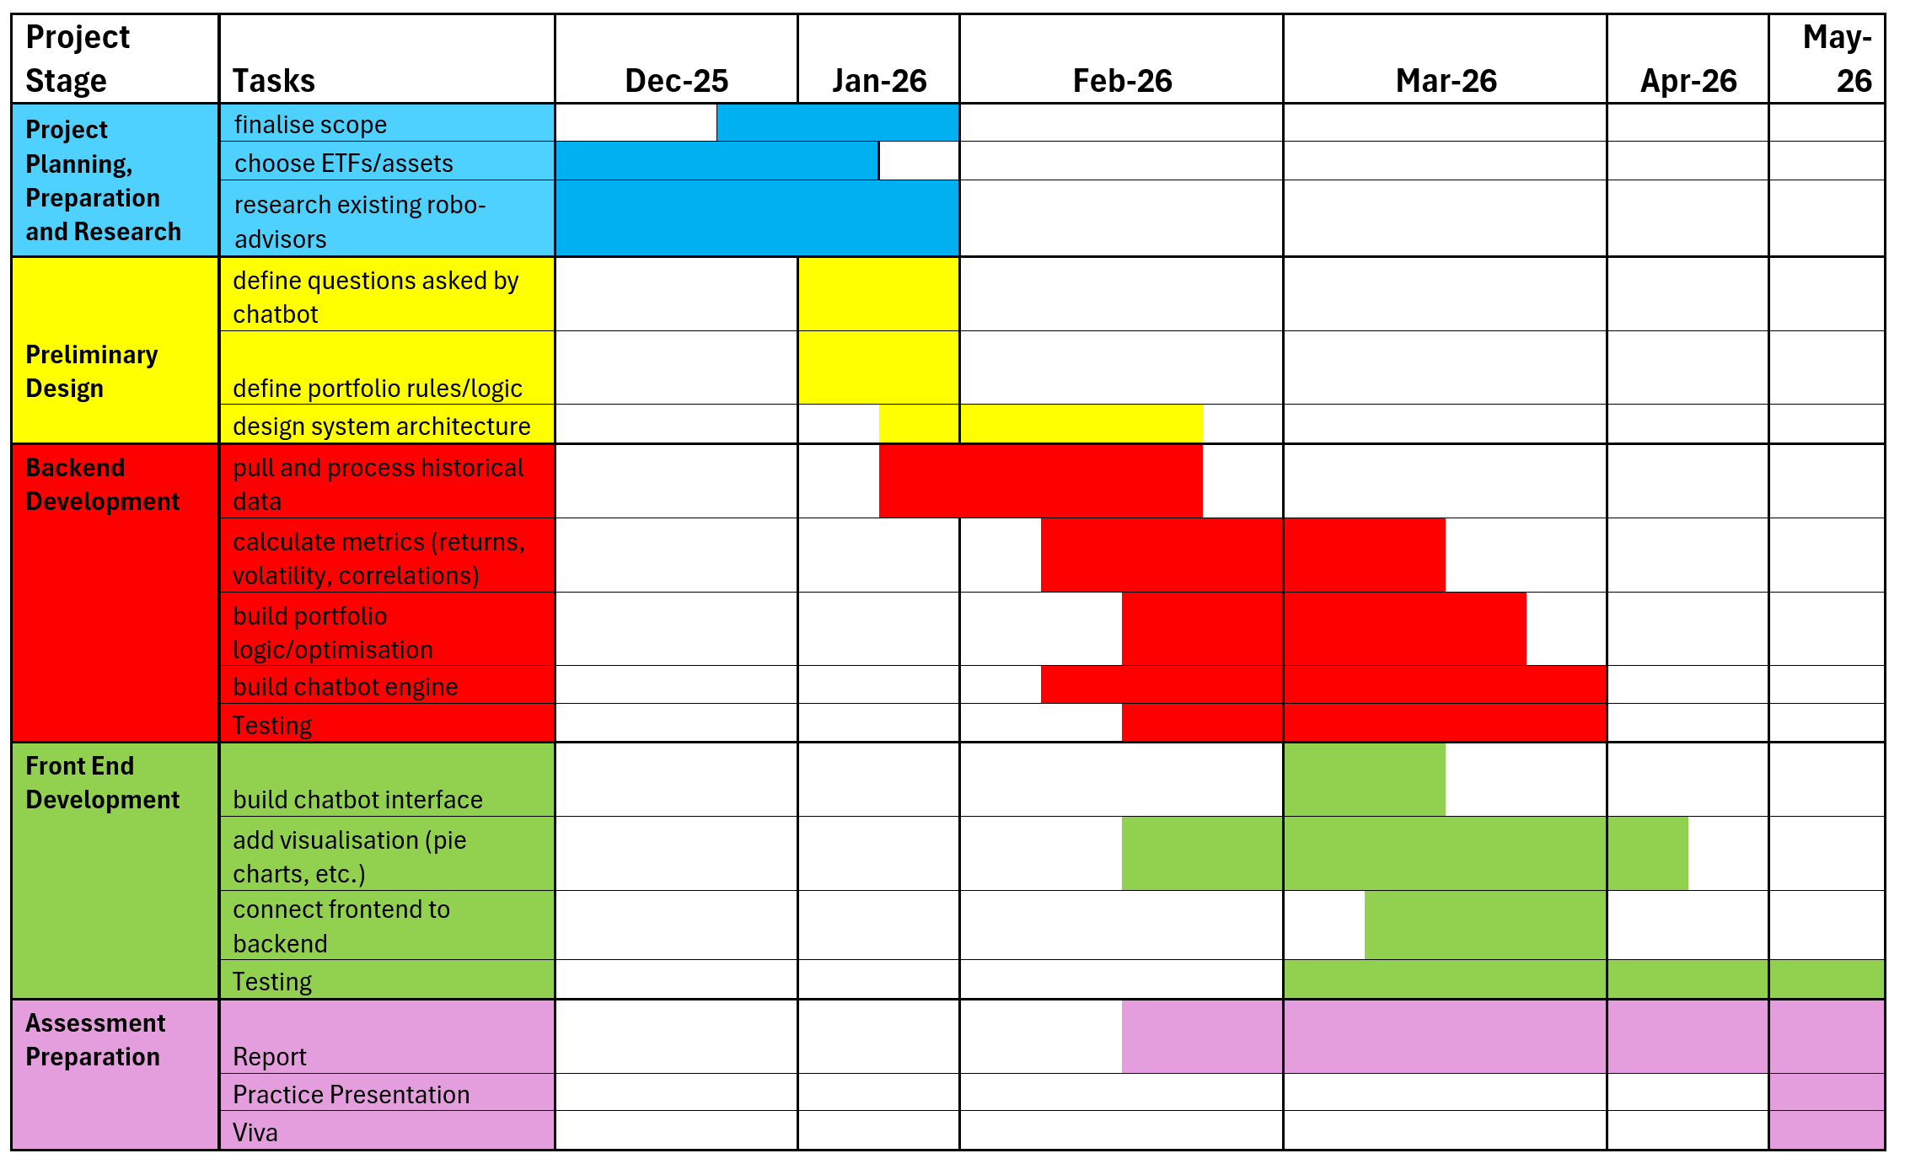
Agile Methodology
Regular meetings & progress reports
Gantt chart
Built in contingency
Kanban planner – sprints
Notes:
https://planner.cloud.microsoft/webui/plan/anMnEFxeW0aHObknSi9OHZYABDcv/view/board?tid=07ef1208-413c-4b5e-9cdd-64ef305754f0

Slide 29
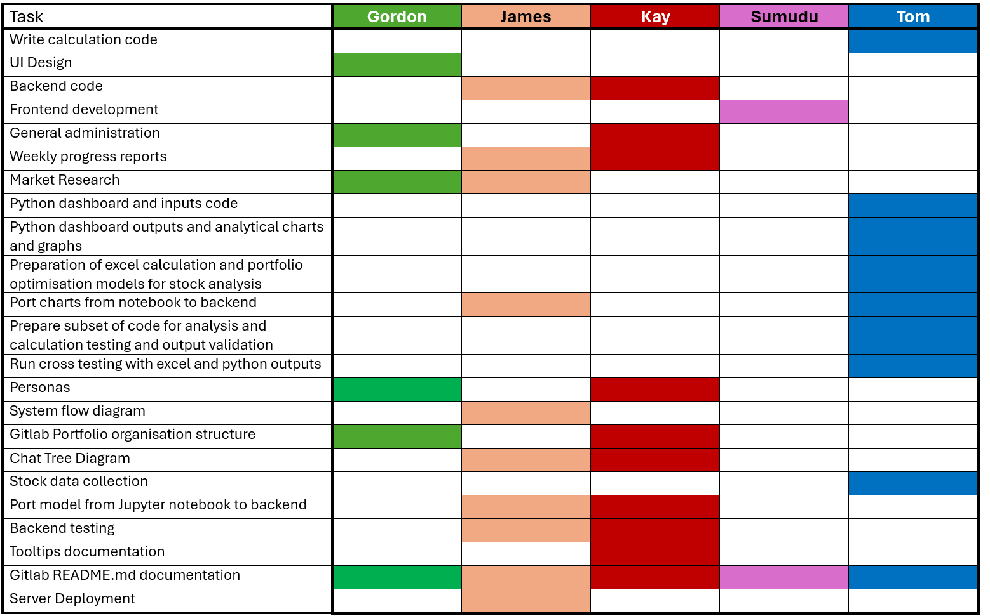
IGP Team 3 - Contribution matrix
Gitlab Repo:
IGP Sept25 Team3 / Portfolio · GitLab

Slide 30

Findings & Reflections
Team worked well together and supported each other
Learnt how to successfully develop a product from start to finish
both robo-advisors give comparable outputs
Some challenges due to sickness absence
Agile methodology works well for this type of project
take account of developments and can incorporate new research
Research could have been done earlier
Started project before exploring personas
Some design decisions started before the research was fully developed

Slide 31

Questions
🚀 LIVE DEMO· Please ask if you’d like to see a live demo of either version of the robo-advisor.

